Slide 1
May 9, 2023

Slide 2

Gentle Introduction to Machine Learning: Classification
A Reproducible Research Workshop
Simon Stone
Research Data Services
Dartmouth College

Slide 3
About the Reproducible Research Group
Joint venture of Research Computing @ ITC and Research Data Services @ Library
Consult with experts on
research data management,
data visualization,
biomedical research support,
spatial data and GIS,
high performance and research computing,
statistical analysis,
economics and social sciences data
Meet the people on campus that support your reproducible research lifecycle
Engage in community discussions to learn from other researchers on campus
Attend a workshop to learn practical tools and tips

Slide 4
About Research Data Services
Research Data Management
Data Management Plans (DMPs) for sponsored projects
Finding and using 3rd party data
Collection and cleaning of data
Organization and documentation
Publishing and Repositories
Data Analysis/Visualization
Textual, numeric, spatial data
Reproducible research workflows
Scripting in R: tidyverse core package (i.e., ggplot, dplyr, tydr, tibble, etc.)
Scripting in Python: NumPy, SciPy, Pandas, Scikit-learn, Matplotlib, Seaborn, (OpenCV, PyTorch, TensorFlow, Tesseract, NLTK, etc.)
Computational Scholarship
Computational project planning
Collections as Data
Storytelling with data and visualizations
Text and data mining
Digital Humanities support
Computational Pedagogy

Slide 5
Work with us
ResearchDataHelp@groups.dartmouth.edu
Jeremy Mikecz Research Data Science Specialist jeremy.m.mikecz@dartmouth.edu dartgo.org/jeremyappts | Simon Stone Research Data Science Specialist simon.stone@dartmouth.edu dartgo.org/meetwithsimon
Lora Leligdon Head of Research Data Services lora.c.leligdon@dartmouth.edu dartgo.org/lora

Slide 6
Gentle Introduction to Machine Learning Intro
Machine Learning is ”the field of study that gives computers the ability to learn without explicitly being programmed.”
- Arthur Samuel, 1959 (paraphrased)
Machine Learning
Deep Learning
Artificial General Intelligence
Machine Learning is what we should call (the current) Artificial Intelligence!

Slide 7
Gentle Introduction to Machine Learning Intro
Aims of this series:
Demystify the field a bit and give context to the buzzwords
A working mental model how machine learning algorithms think calculate
To provide enough knowledge to think critically about “A.I.”
To inspire you to confidently use machine learning in your work and personal life

Slide 8
Gentle Introduction to Machine Learning Intro
Statistics (April 12)
A brief survey of the fundamentals for Machine Learning
Regression (April 25)
How can an algorithm find relationships between two variables?
Classification (May 9)
How can an algorithm put a label on a real-world object?

Slide 9
Gentle Introduction to Machine Learning Intro
Feedback from Intro to Regression:
Continuous to be positive
A little lost in with the math; more about the actual implementation

Slide 10
Basics Intro
Every machine learning model, ever:
Trained model:
Mystery Box
Input data
Output data

Slide 11
Basics Intro
Training process:
Choose a model structure for your problem
Every model has parameters that can be changed to better fit the problem at hand
Show the model plenty of data
Adapt the model’s parameters to best fit the data
Challenge: How do we know what is the “best fit”?

Slide 12
Basics Intro
Every machine learning model, ever:
Evaluation ⚖️
🔧
During Unsupervised Training:
Mystery Box
Training data
Output data

Slide 13
Basics Intro
Every machine learning model, ever:
During Supervised Training:
Mystery Box
Training data
Output data
Training labels
🔧
Evaluation ⚖️

Slide 14
Gentle Introduction to Machine Learning Intro
Supervised Learning
Classification
Regression
Unsupervised Learning
Clustering
Anomaly Detection
Semi-supervised Learning
Mix of labeled and unlabeled data
Self-supervised Learning
Language modeling

Slide 15
Gentle Introduction to Machine Learning Outline
What is “classification”?
20 Questions: Growing a Decision Tree
Similarity-based classification: Nearest Neighbor
The many, many, MANY kinds of classification models
An artificial neural network for classification problems
Case study: Does this person make more than $50,000 per year?
Critical Thinking
Summary

Slide 16
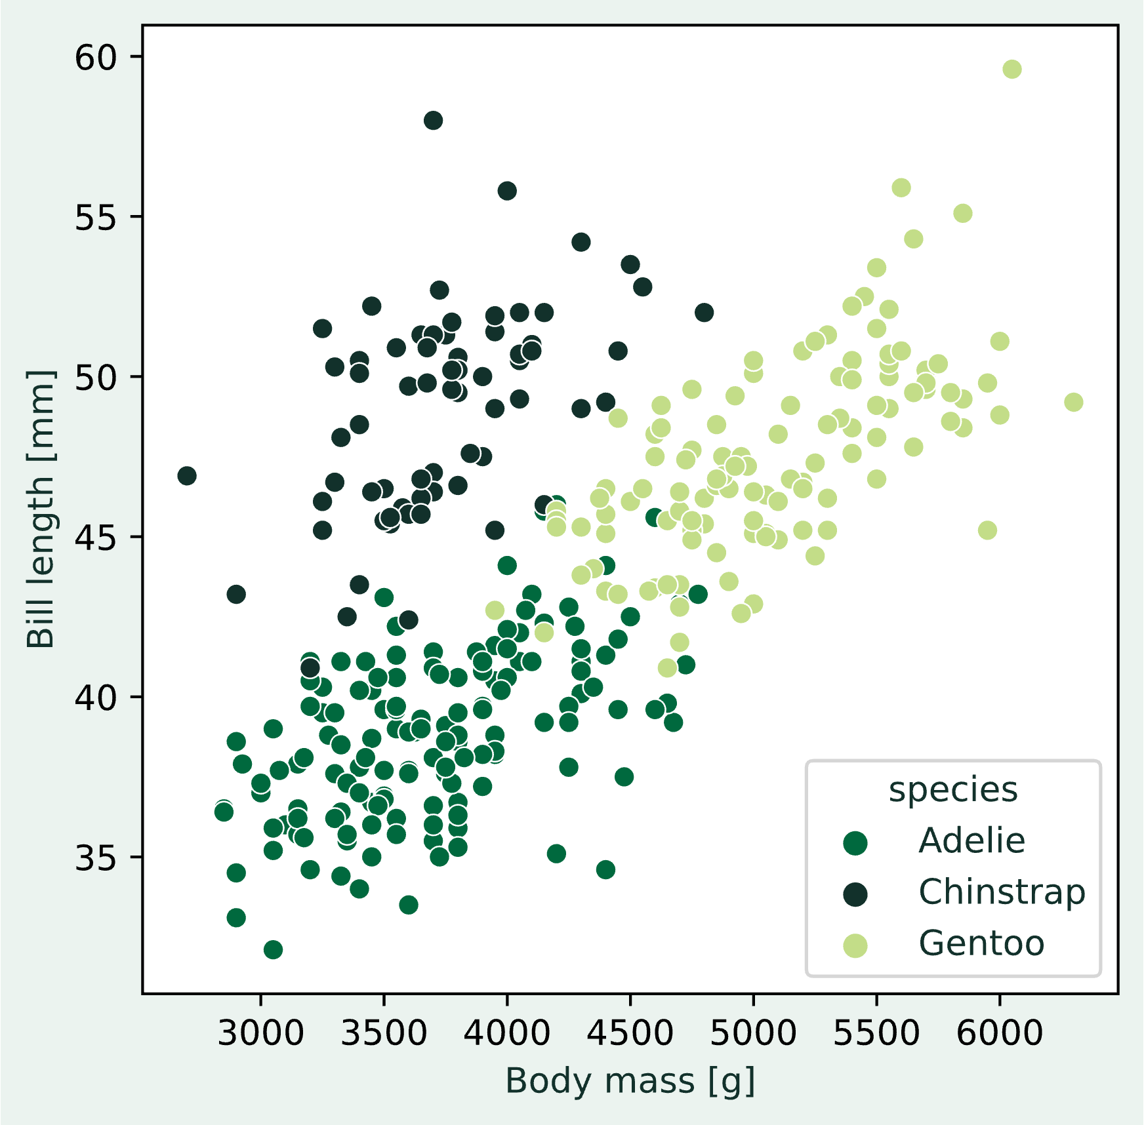
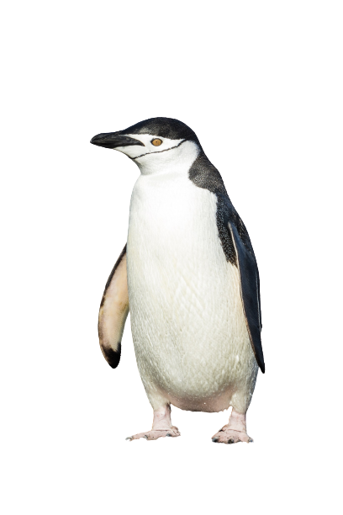
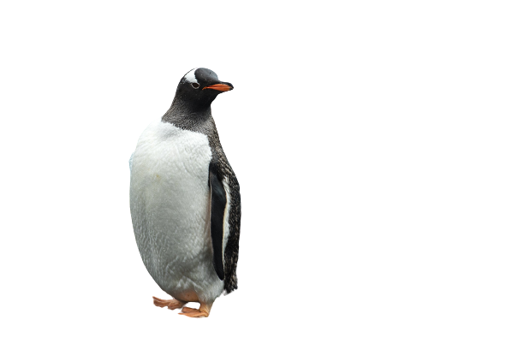
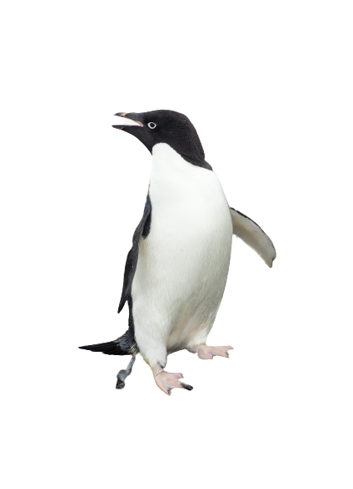
Basics What is “classification”?
Consider the following problem:
We have measurements of the bill length and the body mass of penguins
We suspect that we can tell the species apart based on these two measurements alone
Formulating a causal, biologically-motivated model for this relationship seems difficult
Instead, we try to somehow learn the “rules” for the association from the data itself (supervised learning)

Slide 17
Basics Classification problem or not?
Definition:
We use classification models to associate one or more independent variables with a categorical dependent variable without necessarily knowing the rules for this association.
Activity: Which of these problems could we tackle with a classification model?
Classifying an email as either spam or not spam based on the email's content and metadata.
Identifying similar stories in a corpus of newspaper articles.
Identifying fraudulent transactions in a financial dataset based on transaction amount, location, and time.
Identifying faulty printed circuit boards during production using a camera system.
Predicting whether a patient has a particular disease or not based on blood pressure, cholesterol levels, and genetic markers.

Slide 18
20 Questions Growing a Decision Tree
Activity:
How would you define the rules to determine the species of a new penguin, based on these “labeled” penguins?
Challenge:
How do you find optimal rules?

Slide 19
20 Questions Growing a Decision Tree
Activity:
Someone thinks of a penguin from the sample.
You get to ask 20 “Yes or No” questions regarding its bill length and body mass
What would be good questions to ask?
Answer:
Each question should give you the most information.
Most information means exclude as many options as possible.

Slide 20
20 Questions Growing a Decision Tree
Decision Trees are an algorithmic way to find the optimal sequence of questions
A question in this case is a comparison of a feature’s value to a threshold value, e.g.:
Is the body mass less than to 5000 grams?
A comparison is found by choosing the feature and the threshold value that gives the highest increase in correct classifications at this point

Slide 21
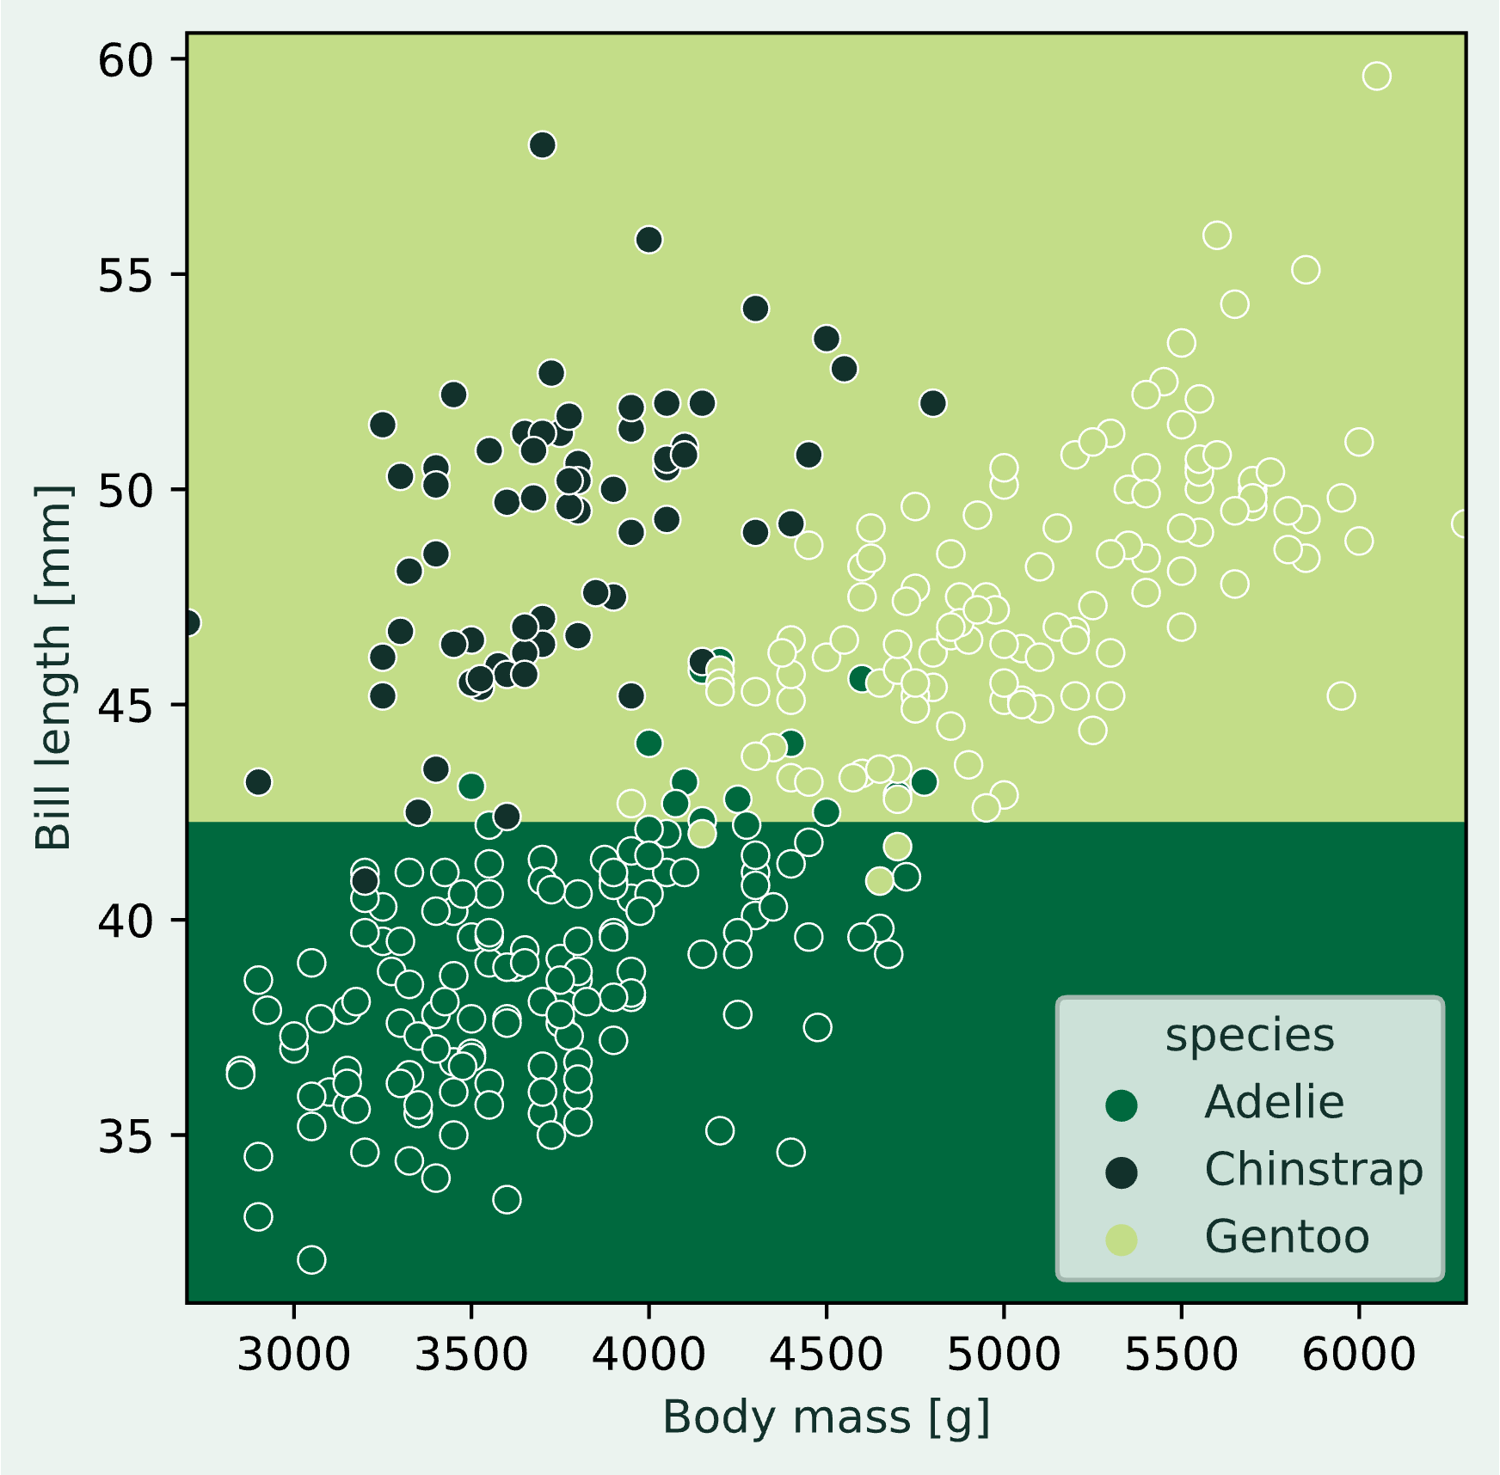
20 Questions Growing a Decision Tree
Gentoo
Adelie
Is the bill length less than 42.35 mm?

Slide 22
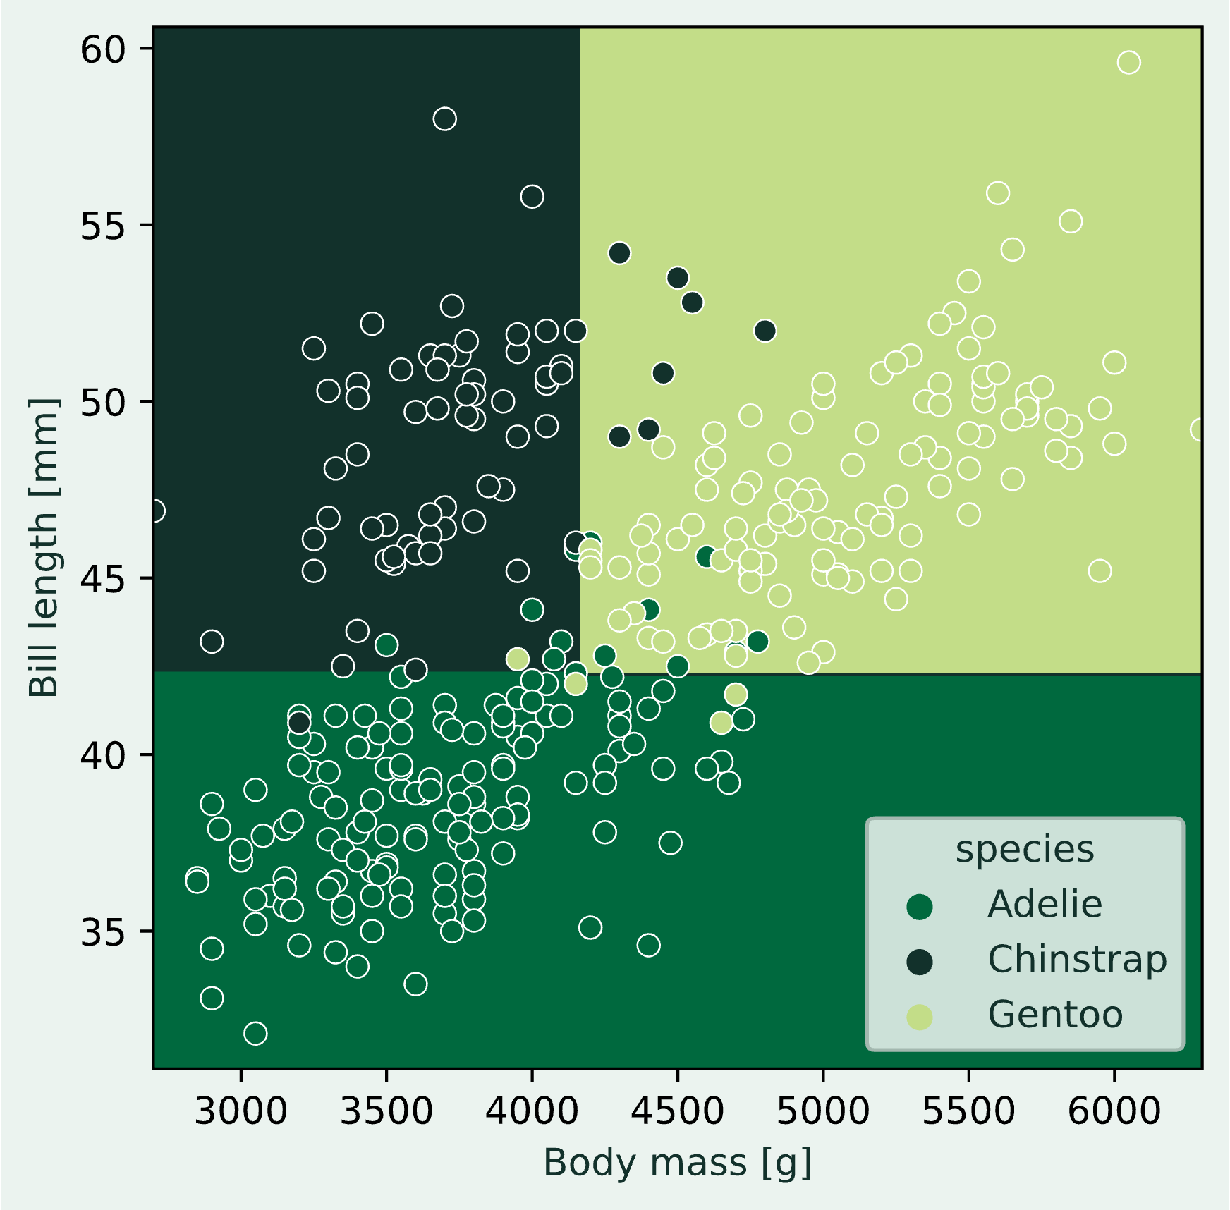
20 Questions Growing a Decision Tree
Is the body mass less than 4175 g?
Is the body mass less than 4625 g?
Is the bill length less than 42.35 mm?
Adelie
Adelie
Chinstrap
Gentoo

Slide 23
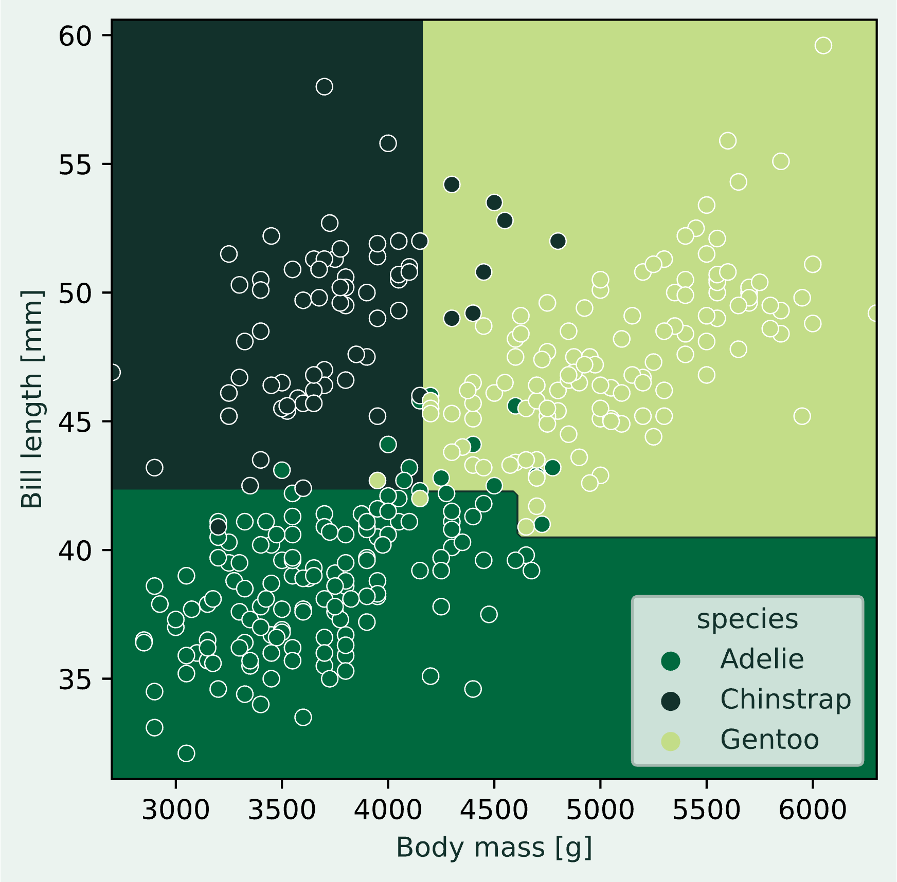
20 Questions Growing a Decision Tree
Is the body mass less than 4175 g?
Is the body mass less than 4625 g?
Is the bill length less than 42.35 mm?
Is the bill length less than 41.9 mm?
Is the bill length less than 40.35 mm?
Is the bill length less than 44.65 mm?
Is the body mass less than 4562.5 g?
Adelie
Adelie
Adelie
Gentoo
Chinstrap
Chinstrap
Gentoo
Gentoo

Slide 24
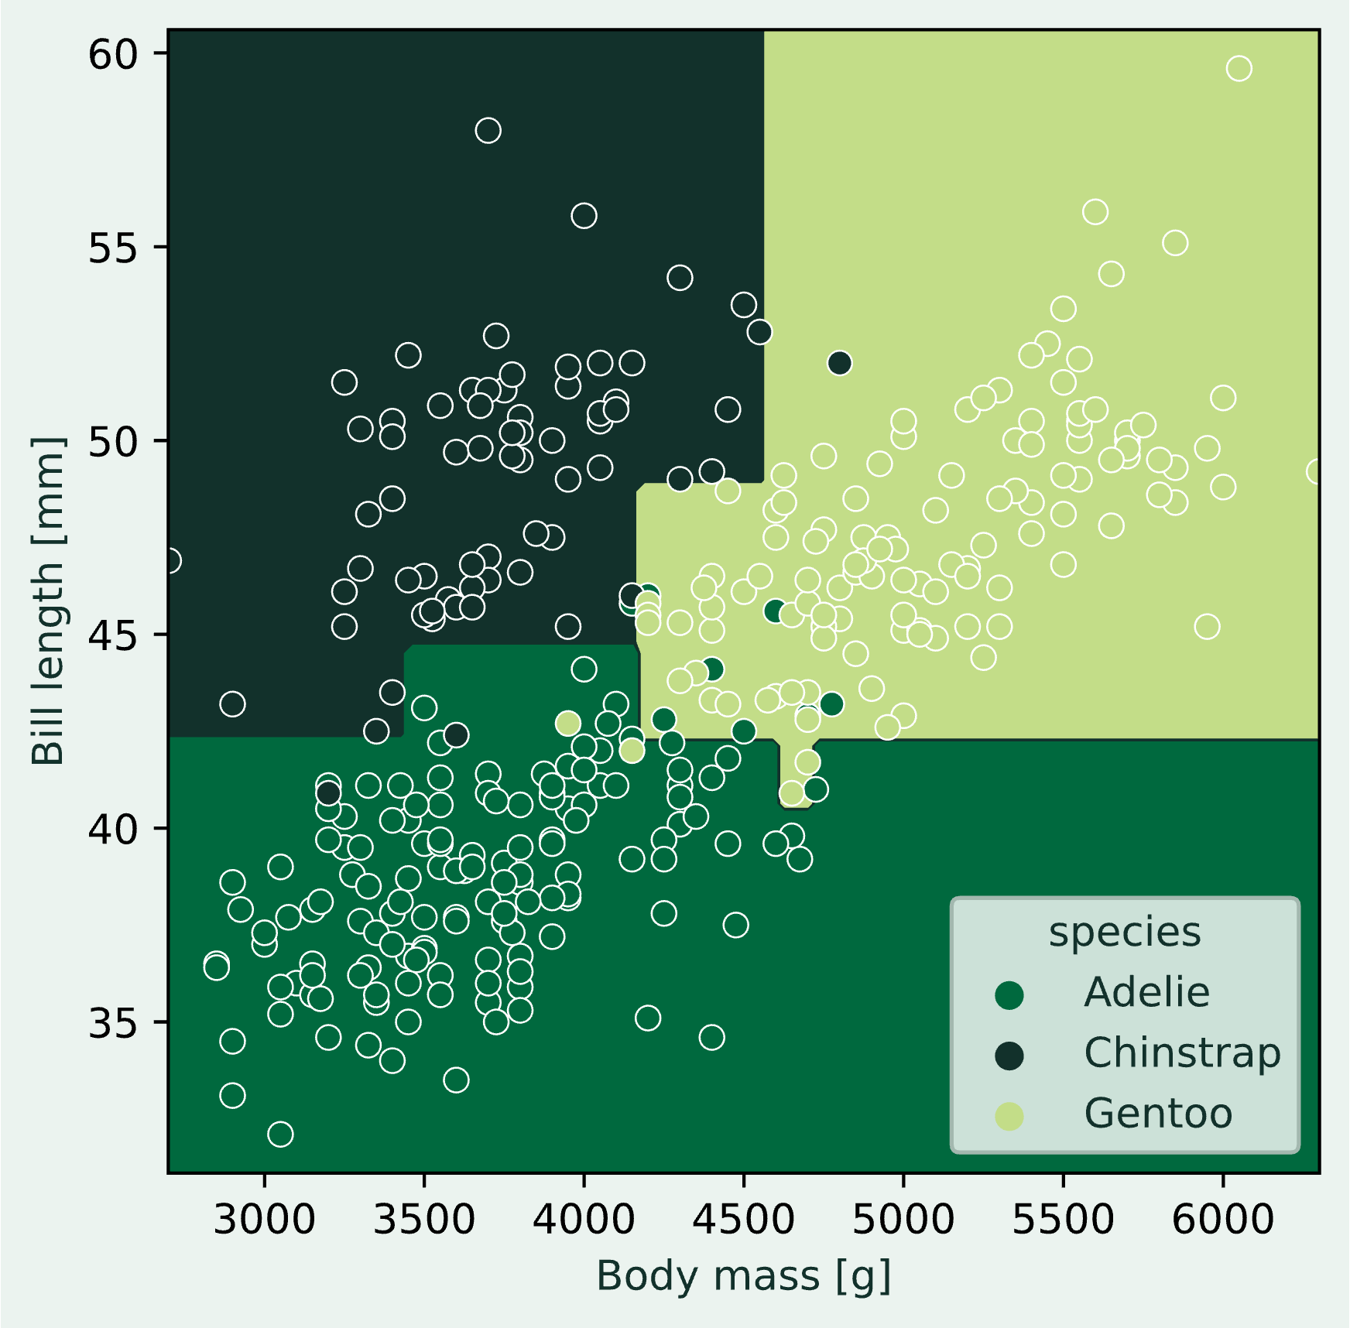
20 Questions Growing a Decision Tree
Is the body mass less than 4175 g?
Is the body mass less than 4625 g?
Is the bill length less than 42.35 mm?
Is the bill length less than 41.9 mm?
Is the bill length less than 40.35 mm?
Is the bill length less than 44.65 mm?
Is the body mass less than 4562.5 g?
Is the bill length less than 40.85 mm?
Is the bill length less than 42.05 mm?
Adelie
Is the body mass less than 4712.5 g?
Is the body mass less than 3450 g?
Is the body mass less than 4125 g?
Is the bill length less than 48.85 mm?
Is the bill length less than 43.25 mm?
Adelie
Adelie
Adelie
Adelie
Gentoo
Adelie
Chinstrap
Adelie
Chinstrap
Chinstrap
Gentoo
Chinstrap
Gentoo
Gentoo

Slide 25
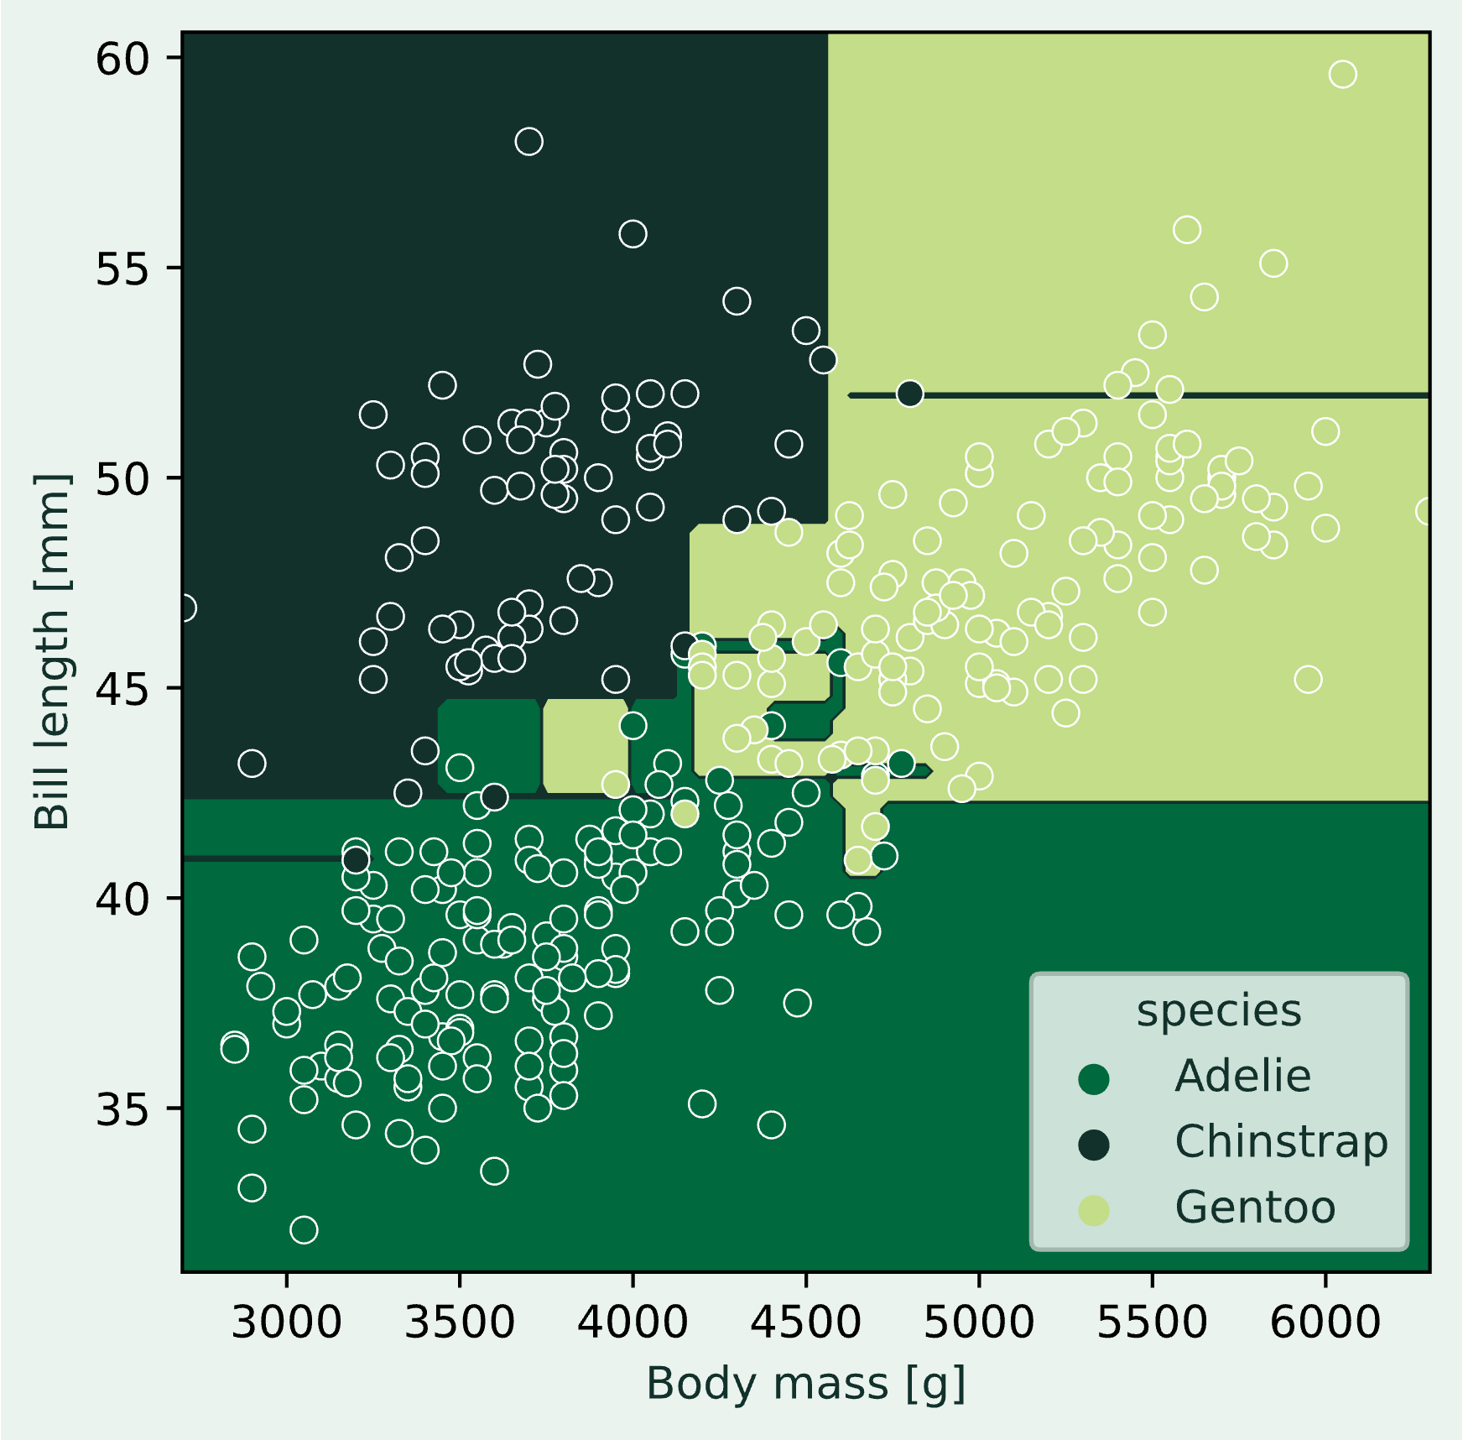
20 Questions Growing a Decision Tree
Is the body mass less than 4175 g?
Is the body mass less than 4625 g?
Is the bill length less than 42.35 mm?
Is the bill length less than 41.9 mm?
Is the bill length less than 40.35 mm?
Is the bill length less than 44.65 mm?
Is the body mass less than 4562.5 g?
Is the bill length less than 40.85 mm?
Is the bill length less than 42.05 mm?
Adelie
Is the body mass less than 4712.5 g?
Is the body mass less than 3450 g?
Is the body mass less than 4125 g?
Is the bill length less than 48.85 mm?
Is the bill length less than 43.25 mm?
Adelie
Is the body mass less than 3262.5 g?
Is the bill length less than 41 mm?
Chinstrap
Adelie
Adelie
Is the body mass less than 4100 g?
Adelie
Gentoo
Adelie
Gentoo
Adelie
Chinstrap
Is the bill length less than 42.55 mm?
Chinstrap
Is the body mass less than 3975 g?
Is the body mass less than 3725 g?
Adelie
Gentoo
Adelie
Chinstrap
Is the bill length less than 45.9 mm?
Adelie
Chinstrap
Is the bill length less than 43 mm?
Adelie
Is the bill length less than 46.05 mm?
Is the bill length less than 45.9 mm?
Is the body mass less than 4375 g?
Gentoo
Is the bill length in mm less than 43.7 mm?
Gentoo
Is the bill length less than 44.6 mm?
Adelie
Gentoo
Adelie
Gentoo
Is the body mass less than 4862.5 g?
Is the bill length less than 42.85 mm?
Gentoo
Adelie
Gentoo
Is the body mass less than 4612.5 g?
Is the bill length less than 44.5 mm?
Gentoo
Is the bill length less than 46.55 mm?
Adelie
Gentoo
Is the bill length less than 51.75 mm?
Gentoo
Is the bill length less than 52.05 mm?
Chinstrap
Gentoo

Slide 26
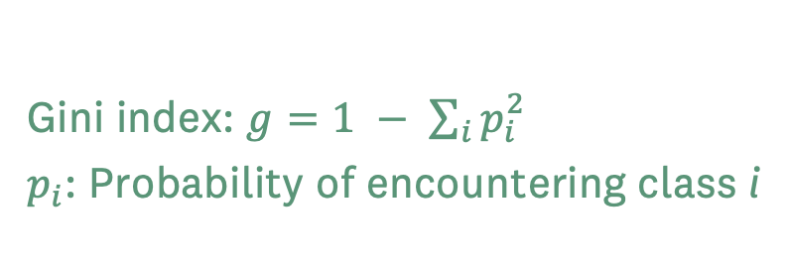
20 Questions Growing a Decision Tree
Gini index: $g=1 − \sum_{i}{p_{i}^{2}}$
$p_{i}$: Probability of encountering class i
Bill length < 35.1 mm?
But how does it work?
Pick a random observation and a feature
Split the remaining data on that value
Calculate some quality criterion (e.g., Gini index)
Compare to previous best split and keep the best
Tried all features of all observations?
No
Yes
Split data; continue down both branches
Adelie: 10
Chinstrap: 0
Gentoo: 0
Adelie: 135
Chinstrap: 119
Gentoo: 68
g₁ = 0.0
g₂ = 0.64
Best so far: 0.62
Weighted average: g = 0.62

Slide 27
20 Questions Growing a Decision Tree
Gini index: $g=1 − \sum_{i}{p_{i}^{2}}$
$p_{i}$: Probability of encountering class i
Bill length < 43.2 mm?
But how does it work?
Pick a random observation and a feature
Split the remaining data on that value
Calculate some quality criterion (e.g., Gini index)
Compare to previous best split and keep the best
Tried all features of all observations?
No
Yes
Split data; continue down both branches
Adelie: 139
Chinstrap: 4
Gentoo: 7
Adelie: 5
Chinstrap: 63
Gentoo: 111
g₁ = 0.14
g₂ = 0.49
Best so far: 0.33
Weighted average: g = 0.33

Slide 28
20 Questions Growing a Decision Tree
Gini index: $g=1 − \sum_{i}{p_{i}^{2}}$
$p_{i}$: Probability of encountering class i
Bill length < 51.3 mm?
But how does it work?
Pick a random observation and a feature
Split the remaining data on that value
Calculate some quality criterion (e.g., Gini index)
Compare to previous best split and keep the best
Tried all features of all observations?
No
Yes
Split data; continue down both branches
Adelie: 146
Chinstrap: 54
Gentoo: 110
Adelie: 0
Chinstrap: 14
Gentoo: 9
g₁ = 0.62
g₂ = 0.48
Best so far: 0.33
Weighted average: g = 0.61

Slide 29
20 Questions Growing a Decision Tree
Gini index: $g=1 − \sum_{i}{p_{i}^{2}}$
$p_{i}$: Probability of encountering class i
Bill length < 42.35 mm?
Best: 0.328
But how does it work?
Pick a random observation and a feature
Split the remaining data on that value
Calculate some quality criterion (e.g., Gini index)
Compare to previous best split and keep the best
Tried all features of all observations?
No
N = 138
Body mass < 4625 g?
N = 195
Yes
Split data; continue down both branches
…
…

Slide 30
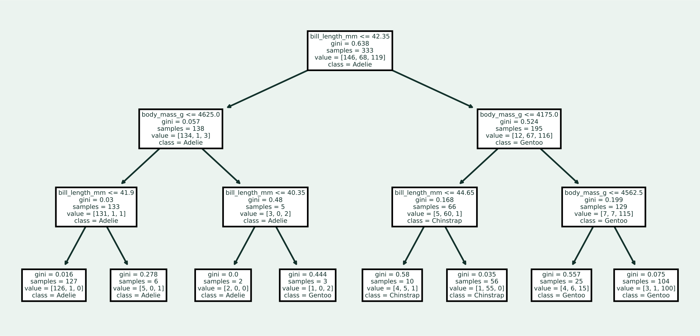
20 Questions Growing a Decision Tree

Slide 31
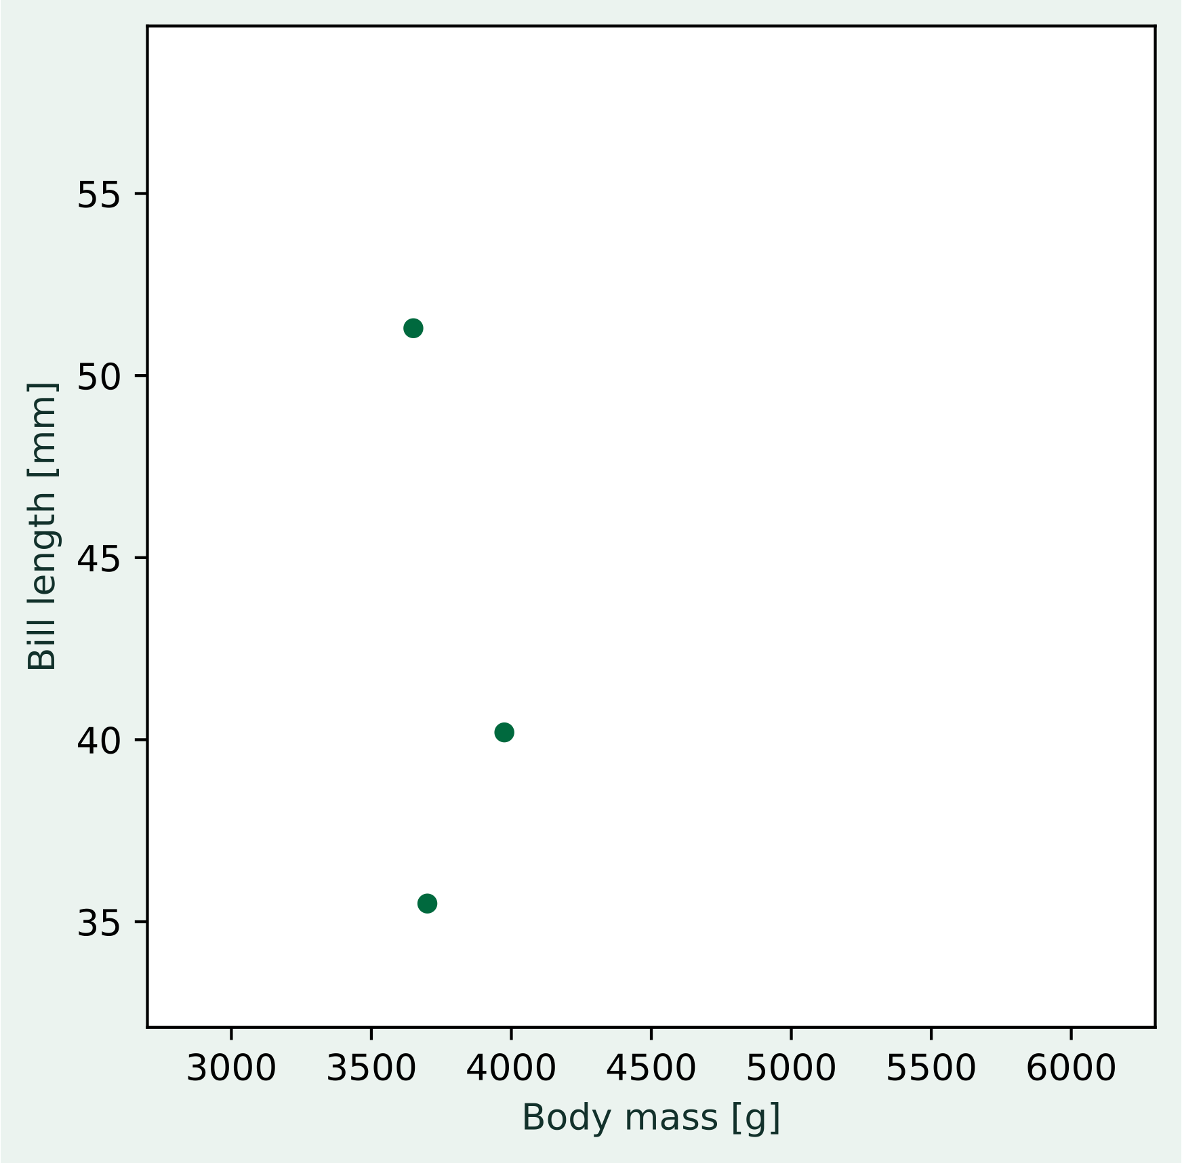
Similarity-based classification Nearest Neighbor
Another approach to the problem of labeling a new observations is by determining its similarity to observations with known labels.
Challenge:
How can we define similarity?
Activity:
Which penguins are more similar than others?

Slide 32
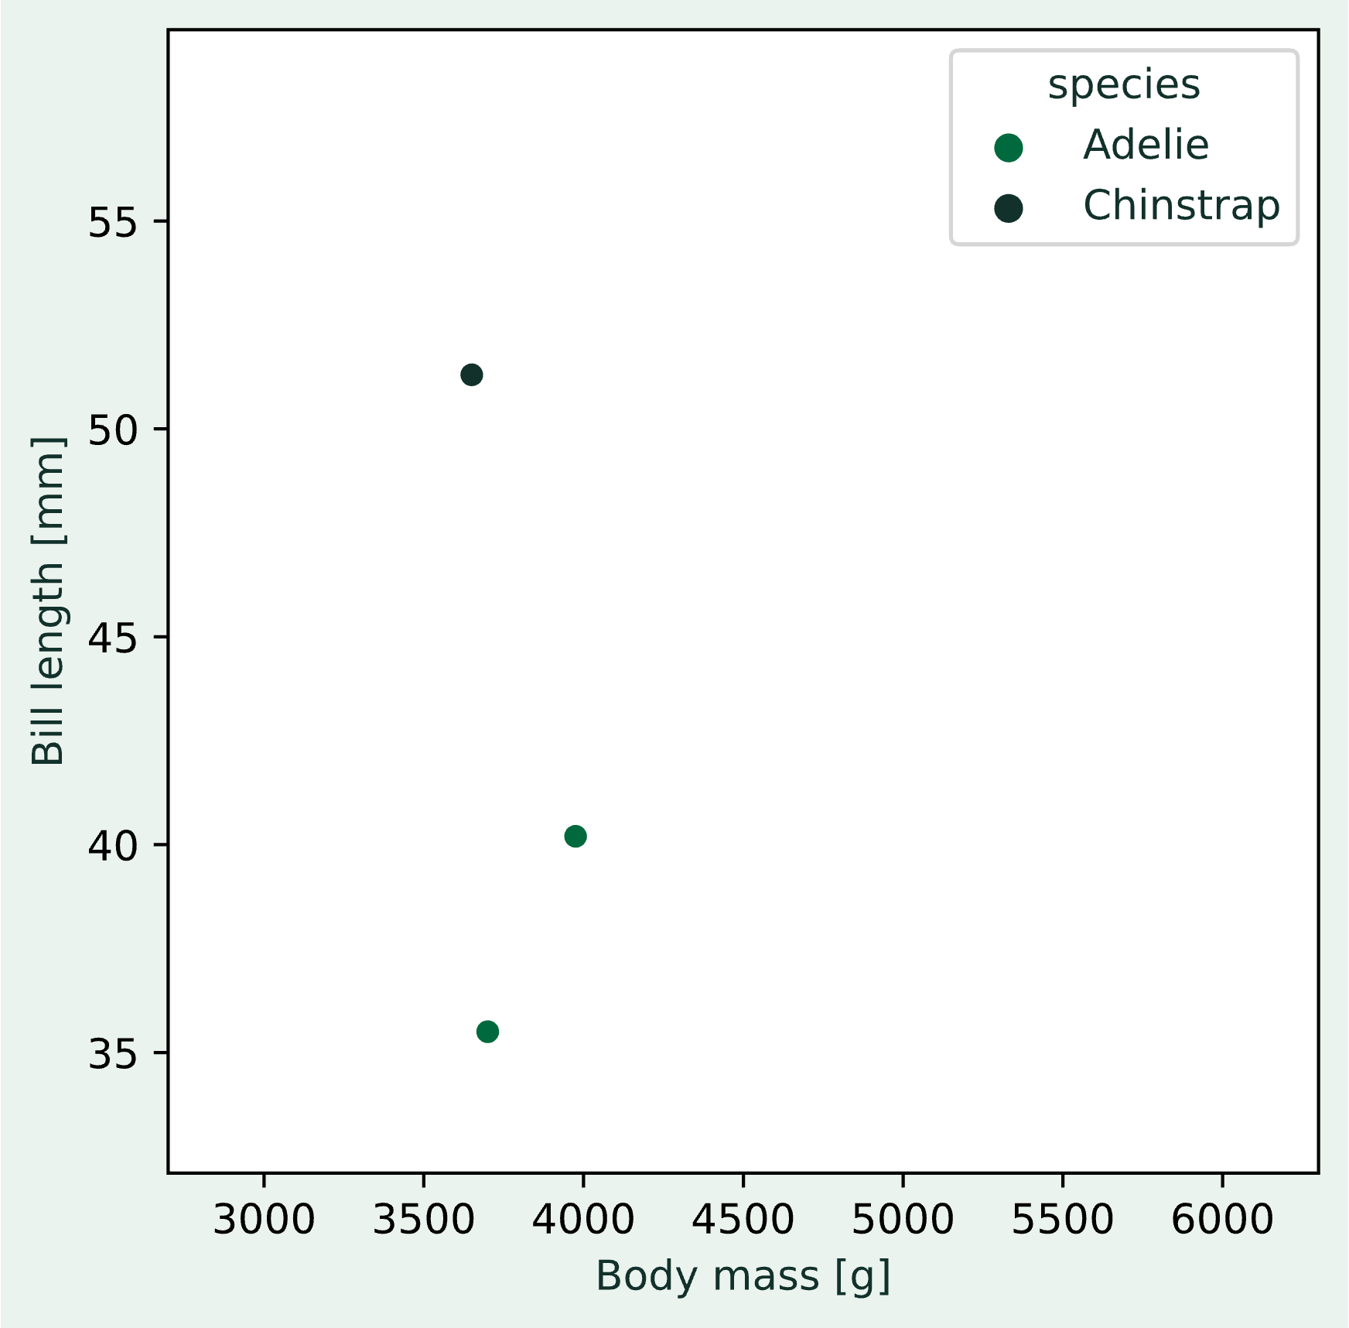
Similarity-based classification Nearest Neighbor
Another approach to the problem of labeling a new observations is by determining its similarity to observations with known labels.
Challenge:
How can we define similarity?
Activity:
Which penguins are more similar than others?

Slide 33
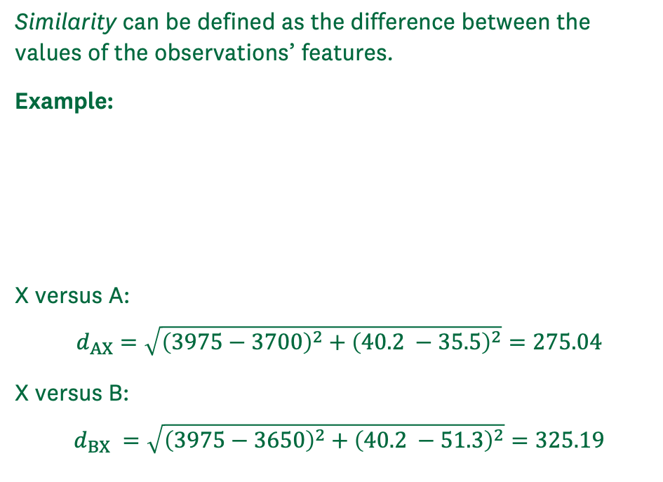
Similarity-based classification Nearest Neighbor
Similarity can be defined as the difference between the values of the observations’ features.
Example:
X versus A:
$$d_{AX}=\sqrt{{\left(3975−3700\right)}^{2}+{\left(40.2 −35.5\right)}^{2}}=275.04$$
X versus B:
$$d_{BX} =\sqrt{{\left(3975−3650\right)}^{2}+{\left(40.2 −51.3\right)}^{2}}=325.19$$
B
Penguin | Body mass [g] | Bill length [mm]
X | 3975 | 40.2
A | 3700 | 35.5
B | 3650 | 51.3
X
A

Slide 34
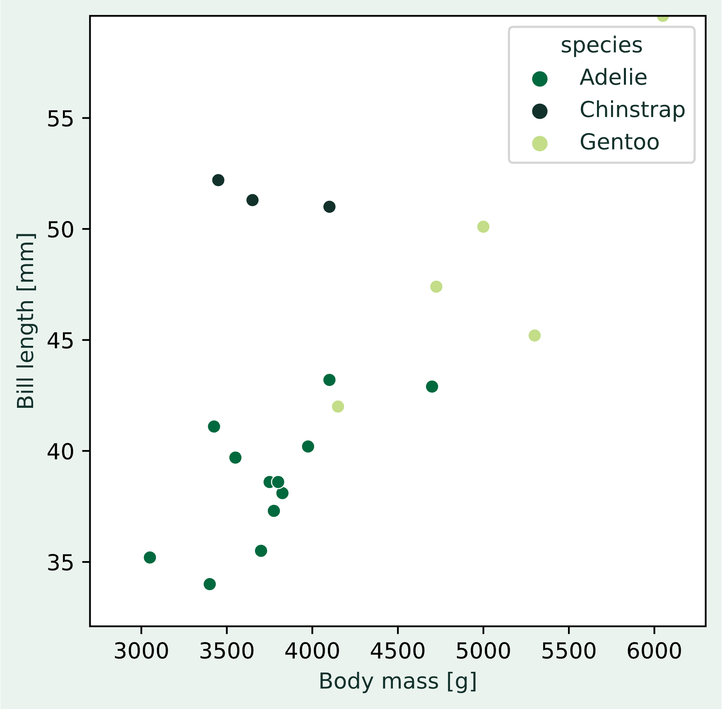
Similarity-based classification Nearest Neighbor
Activity:
What about this situation though?
Challenge:
The nearest neighbor is misleading.
How can we adapt our algorithm to find a label for X more robustly?
Solution:
Look at multiple neighbors and determine the most frequent label among them (the statistical mode)!
X
B
A

Slide 35
Similarity-based classification Nearest Neighbor
k-Nearest Neighbor classifier:
Calculate the similarity between the new observation to be classified and all training observations
Take the top k most similar training samples
Determine the mode of their label (most frequent label)
Label the new observation with that label
Options in the algorithm:
Number of neighbors to consider (k)
Measure of similarity
Challenge:
How do you find the optimal options?
X
B
A

Slide 36
Beyond this session The many, many, MANY kinds of classification models
Logistic Regression
Support Vector Machines
Gaussian Process Classification
Naïve Bayes
Decision Trees
Ensemble methods (“model zoo”)
Neural Networks
They each have individual strengths and weaknesses with regards to:
Amount of data needed
Computational complexity during training
Computational complexity when making predictions
Adaptability to new observations
In most cases, nobody can say in advance which model will have the highest accuracy.
The only way to know for sure is to try them all out!

Slide 37

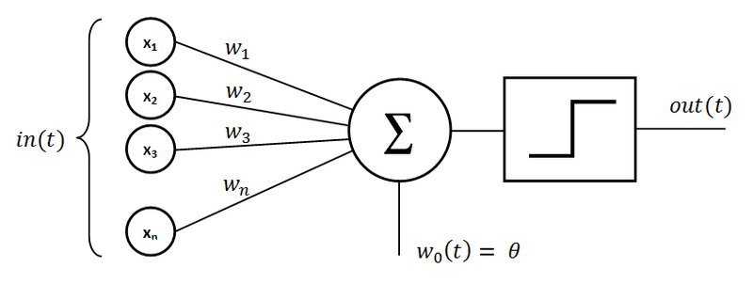
Neural Networks for classification problems The Perceptron
A biological neuron
Rosenblatt’s Perceptron (1985)
User:Dhp1080, CC BY-SA 3.0, via Wikimedia Commons
Mayranna, CC BY-SA 3.0, via Wikimedia Commons

Slide 38
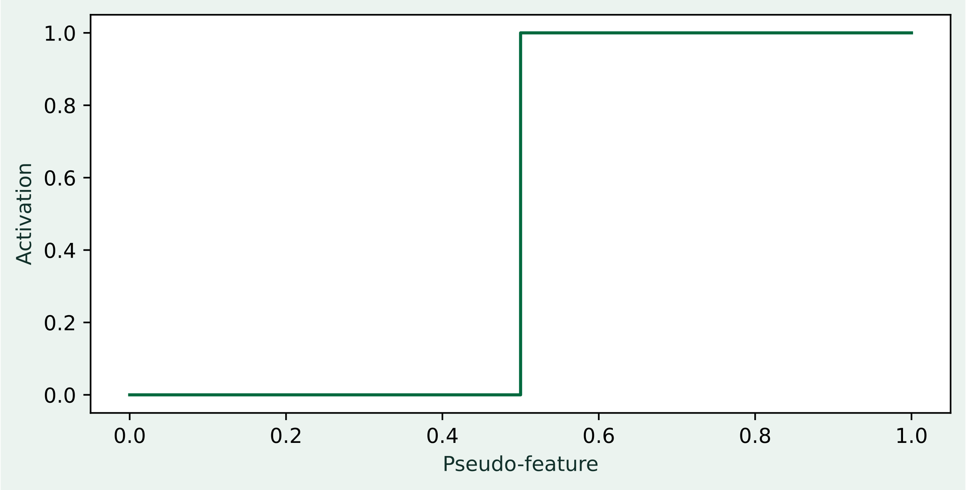

Neural Networks for classification problems The Perceptron
The perceptron consists of a linear regression part and an activation function.
We can think of the regression part as a transformation of the n input features onto a single pseudo-feature.
Depending on the value of that pseudo-feature, the activation function either signals an active or inactive perceptron.
Activation function
inactive
active
$$y=w_{0}+w_{1}x_{1}+ ⋯$$
Mayranna, CC BY-SA 3.0, via Wikimedia Commons

Slide 39
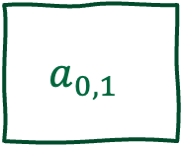

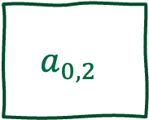
Neural Networks for classification problems A Network for Penguins
Each neuron can only determine the presence or absence of a single class (one-versus-all)
For our three penguin species, we therefore need three neurons
Challenge:
How to deal with ambiguous output?
Answer:
Swap out the activation function!
$$a_{0,0}$$
Adelie?
0 or 1
Body mass
$$a_{0,1}$$
Chinstrap?
0 or 1
Bill length
$$a_{0,2}$$
Gentoo?
0 or 1

Slide 40
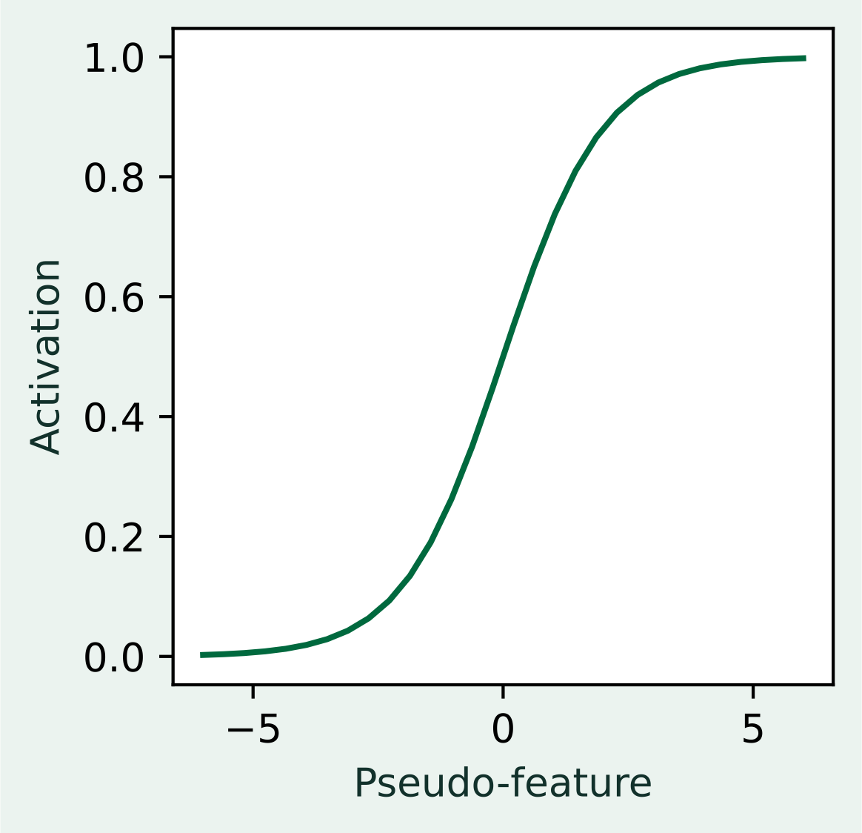
Neural Networks for classification problems A Network for Penguins
Each neuron can only determine the presence or absence of a single class (one-versus-all)
For our three penguin species, we therefore need three neurons
Challenge:
How to deal with ambiguous output?
Answer:
Swap out the activation function!
The output can now be interpreted as a probability for each class
$$a_{0,0}$$
Adelie?
0…1
Body mass
$$a_{0,1}$$
Chinstrap?
0…1
Bill length
$$a_{0,2}$$
Gentoo?
0…1

Slide 41
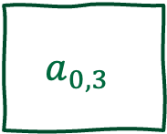
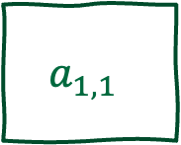
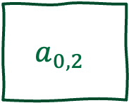
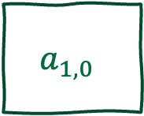
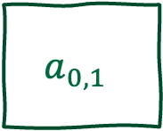
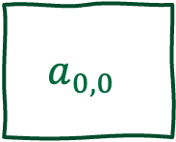
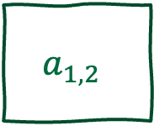
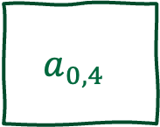
Neural Networks for classification problems A Network for Penguins
$$a_{0,0}$$
We could also add an additional layer that creates a new set of pseudo-features of higher dimensionality than the original features.
Higher dimensionality can help distinguish observations that are otherwise similar in a lower-dimensional space.
A final output layer will then once again map the pseudo-features to the class probabilities
Neural networks therefore often have a diamond structure:
Projection from a low-dimensional into a high-dimensional space
Projection from high-dimensional space to output space
$$a_{0,1}$$
$$a_{1,0}$$
Adelie?
0…1
Body mass
$$a_{0,2}$$
$$a_{1,1}$$
Chinstrap?
0…1
$$a_{0,3}$$
$$a_{1,2}$$
Gentoo?
0…1
Bill length
$$a_{0,4}$$

Slide 42
Neural Networks for classification problems Training and limitations
Neural networks are trained using gradient-based methods (backpropagation and gradient descent)
Despite the similarity to linear regression, the optimal solution cannot be found in one set of equations because of the layered structure
The training works iteratively instead is thus time-intensive
The flexibility comes at the cost of larger number of parameters, which requires large amounts of data (rule of thumb: one observation per parameter)
With readily-available compute power and large amounts of data, neural networks are a frequent choice in machine learning problems

Slide 43
Case study Does this person make more than $50,000 per year?
Demo

Slide 44
Critical thinking Classification
What is the motivation for the choice of the reported model?
Do the features seem to be descriptive of the objects to be classified?
Is there enough data to generalize?
What is the model’s performance per class?
Were the hyperparameters tuned?
Can the model be interpreted?

Slide 45
Summary Key take-aways
Classification models describe a relationship between independent variables and a categorical dependent variable
The relationship is described in terms of derived rules or similarity
Many models exist with individual strengths and weaknesses
Neural networks can be considered pseudo-feature generators that create new features that can help disambiguate observations

Slide 46
References
In-depth books:
Bishop. (2006). Pattern recognition and machine learning. Springer.
Russell, S. & Norvig, P. (2022). Artificial intelligence : a modern approach (4th ed.). Prentice Hall/Pearson Education.
Great video series on neural networks:
https://www.youtube.com/playlist?list=PLZHQObOWTQDNU6R1_67000Dx_ZCJB-3pi

